Slide 1
Intro project motordive and IR sensor
IT-Technologies/intro project
Ruslan Trifonov

Slide 2

Agenda
Intro to PWM
Intro to motoboard
Intro to sensoryboard

Slide 3
PWM
Pulse width modulation
A pulse to control motor. Better than linear drive. Loses
Other applicaiton, data, Communications
Power flow is not constant. Pluse train needs to be fast enough, inductive load, plus passive electronics to stabilize it.
Sampling frequency. Samples per time unit. Fs = 1/T
Sampling rate. The double rate rule.
Duty cycle, on/off time. 100% means max volts, 0%means gnd

Slide 4
Duty Cycle
Servo motors have fixed values for example duty cycle 10% with frequency of 50Hz.
So frequency/perdio, how often for how long. So a servo updates every 20ms(period) with pulse 2ms. So 2ms is 10% and 20ms is 50Hz. That gives 180 degrees on the servo.
http://digital.ni.com/public.nsf/allkb/2AC662081E01E1AE86257F5D00011B6D

Slide 5
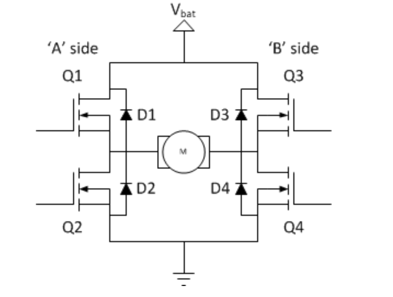
H-Bridge
http://www.modularcircuits.com/blog/articles/h-bridge-secrets/h-bridges-the-basics/

Slide 6
Board
See datasheets
See companion site
http://www.modularcircuits.com/blog/articles/h-bridge-secrets/h-bridges-the-basics/

